Slide 1
The Maskomatic Dispenser
By The Dream Team
Notes:
Helena will do slide 5,6,7
Waleed will do slides 1 & 2
Avery will do slides 3 & 4
Jayden will do slides 8,9,10

Slide 2
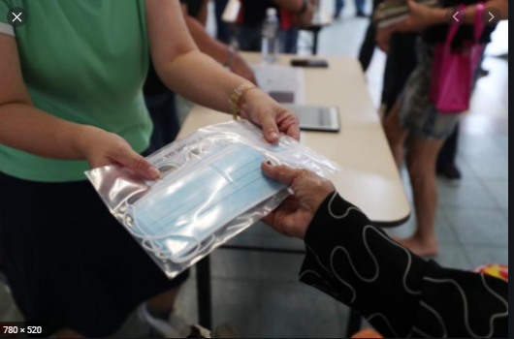
The Motivating Cause Behind The Dispenser
With the current pandemic, it is imperative that people wear personal protective equipment (PPE) when in public, in particular masks.
Dispenser efficiently delivers equipment in a contact-free manner, as to limit the potential spread of disease, and upon user request. While this seems like a no-brainer, many businesses have utilized employees to give out the new PPE. While this provides a cost-effective solution, it is not a sterile one and that is problematic.
The ideal candidates for our device would be businesses who see a great deal of traffic from entering and leaving their buildings that do not have PPE up to par with the business’ standards. The users of the device would be the customers themselves, as this is the group requiring the enhanced PPE. The device will be designed for inside use.
Image from Straits Times.
Distributing masks in this manner is quite risky and The Dream Team has taken it upon themselves to do something about it.

Slide 3
Quantitative Project Goals- Short term
With the release of the initial product, it satisfies a criteria of quantitative specifications:
Dispense one mask upon activation and can dispense 10 consecutive masks without jamming.
Mask must be dispensed within 10 seconds with a cooldown of 10 seconds to prevent overuse.
The dispenser is made with a budget of $150 or less.
Has a 100% success rate with any household outlet.
There is zero human contact

Slide 4
Quantitative project goals-long term
For the shipped product, the dispenser needs to satisfy a different set of requirements.
Should be able to hold a minimum of 50 masks and be able to dispense all of them without jamming
The dispenser should weigh less than 5 pounds and draw a maximum of 2.5 Watts.
It should have a clean look with no extra holes, cuts, have a smooth surface (survey for approval >75% )
Make little to no noise during operation (less than 60 dB).
The dispenser can be easily reloaded under 30 seconds.
The final price of the product for the customer will be a maximum of $80.

Slide 5
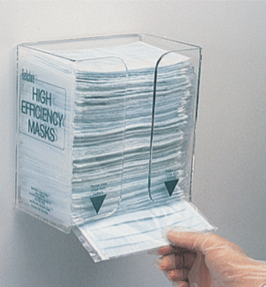

Competitive Analysis
Non-Mechanical Face Mask Dispensers
Online Shopping/ Delivery Services

Slide 6
Manual Mask Dispenser Pros & Cons
Pros
Can be mounted anywhere because of how light it is
Attachment process won’t require a lot of labor, tools, or equipment
Relatively cheap as it is just acrylic housing with masks inside
Does not require power
Reliable as it does not require complex 4-bar mechanisms or electronics
Cons
No limit on how many masks one can take
Contamination risk is higher
When someone takes a mask, there is a high chance of touching other masks, and spreading germs/viruses

Slide 7
Online Services Pros & Cons
Pros
More convenient to customers, which leads to more business
Sterile as customers don’t need to enter store
Safer for employees, as it eliminates direct person-to-person interaction
Ideal for customers with limited mobility
Cons
Overhead cost of creating/maintaining delivery service system
Requires dedicated host website, delivery drivers, and vehicles
Labor costs of drivers, delivery managers, and app programmers
Very limited service provided if used in healthcare services (telehealth)

Slide 8
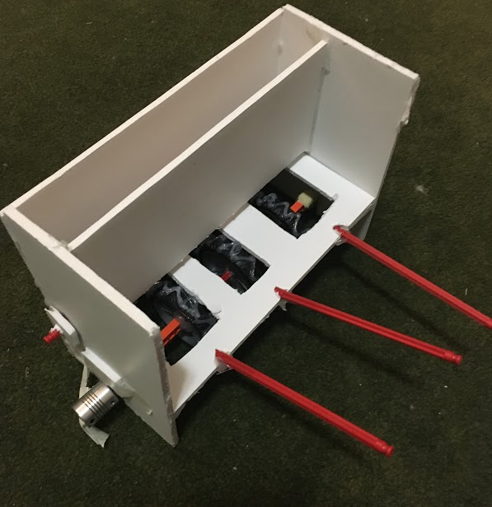
Critical Path Takeaways
Need to dispense one mask
Dividing wall required tight tolerances for dispensing
2 main paths:
dispensing from the top (using a spring)
From the bottom (gravity-fed)
Top dispensing mechanism proved to be more complex
E.g Upward pressure required to create desired friction with wheels.
For the wheels, important to consider coefficient of friction
Would determine design of wheels
Protrusion height of wheels for successful mask dispensing

Slide 9
Prototype Demo and Performance
Goals Met
Contactless dispensing - (Ultrasonic sensor triggers the motor to begin)
Only dispenses when prompted
Masks are dispensed one at a time
Masks can be dispensed from stack or just one left
Can hold up to 50 masks
Easy access to reload masks
Laser emitter senses whether masks were dispensed and triggers the LED
Stayed under budget
Minimal noise
Between 5 and 10 pounds (weight can be reduced in shipped product)
Goals Not Met
Gear misalignment prevents masks dispensed in a row
Gear and motor connection not functional (disconnected the electrical from mechanical components))
Clean look was hindered by manufacturing method

Slide 10
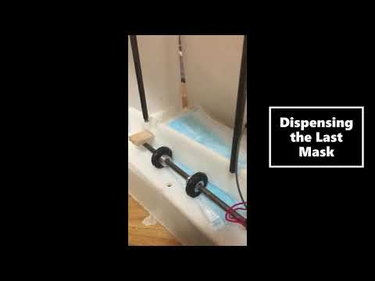
Demo

Slide 11
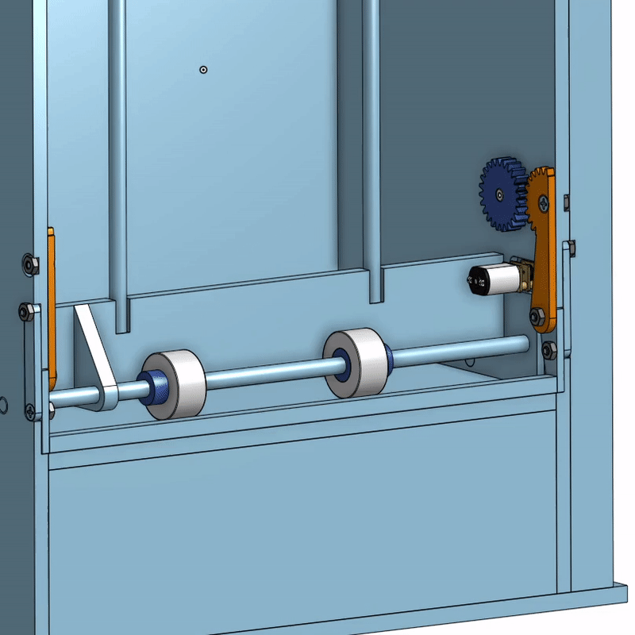
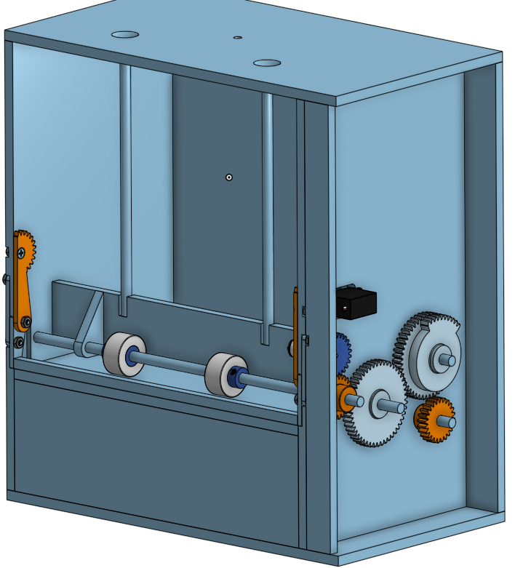
Additional Graphics

Slide 12
